Slide 1
MONETARY ECONOMICS & INDIAN BANKING
UNIT 2

Slide 2
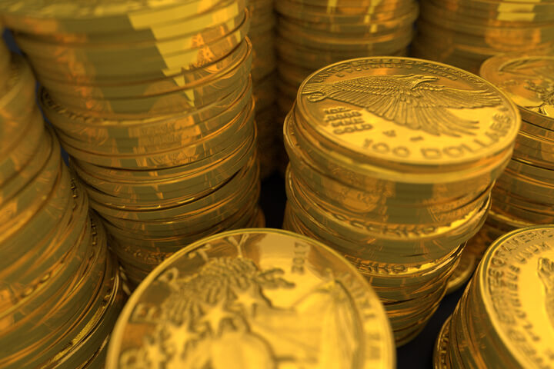
MONEY STANDARD
.
The money standard is a system in which the value of money is determined by a fixed quantity of a valuable commodity such as gold or silver. The use of a money standard helps to prevent inflation, as the supply of money is limited by the availability of the valuable commodity. The gold standard, which was used by many countries in the past, is an example of a money standard.
Types of Monetary Standards :---Overall, there can be two main kinds of monetary standards – metallic standards or paper standard. Metallic standards themselves can be of two types – monometallism and bimetallism. Let us take a more detailed look at the types of monetary standards.
Also known as Single Standard, here only one metal is adopted as the standard currency/money. The monetary system is made up of and relies entirely on one metal, like say the gold standard or the silver standard. So, coins are made up of one metal only. This means these coins are the legal tender for all day-to-day transactions. There is unlimited manufacture of coins, i.e., free coinage.
1. Monometallism
This Photo by Unknown Author is licensed under CC BY-ND

Slide 3
2. Bimetallism
As the name suggests, in the double standard or bimetallism system, two metals are adopted as standard money. There is a fixed legal ratio between the value of the two metals to facilitate exchange. Usually, the two metals are gold and silver. So, two types of standard coins are minted (gold and silver).
So, under bimetallism, two types of metal coins are in circulation simultaneously in the economy. Both have free coinage. And using the legal ratio of exchange both are convertible into each other. One main advantage of this system is that the economy has a full-bodied currency. Silver can be used for the smaller transactions and gold for the bigger ones.
3. Paper Currency Standard
Under this monetary standard, the currency prevailing in the economy will be paper currency. In most cases, this currency system is managed by the Central Bank of the country, RBI in the case of India, and so we can also call it Managed Currency Standard. The currency consists of bank notes and government notes.
Most countries of the world follow this monetary standard. This is because it is a managed and controlled system. So, an authority will monitor the quantity of money supply keeping in mind the stability in prices and income in the economy. It is also very economical in terms of production (currency notes). And they are far more convenient than metallic standards.

Slide 4
Value of Money
The value of money refers to the purchasing power of a unit of currency. The value of money is determined by the amount of goods and services that can be purchased with it. The value of money can change over time due to factors such as inflation or changes in the supply and demand of goods and services.
The device of index numbers comes to our aid in measuring changes in the value of money or price level. An index number is a statement in the form of a table which represents a change in the general price level. Index numbers have great importance in these days. When it is desired to find out to what extent prices have risen or fallen, an index number is prepared. In every advanced country, index numbers are being regularly prepared officially by the governments and also non-officially by other bodies interested in economic changes.
Index Numbers:
This Photo by Unknown Author is licensed under CC BY

Slide 5
THANK YOU

